Slide 1
Section R.6
Synthetic Division
Copyright © 2012 Pearson Education, Inc. Publishing as Prentice Hall.

Slide 2
Copyright © 2012 Pearson Education, Inc. Publishing as Prentice Hall.

Slide 3
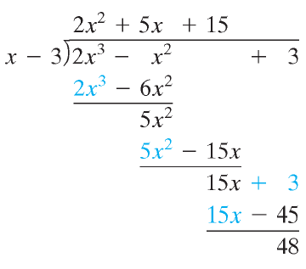
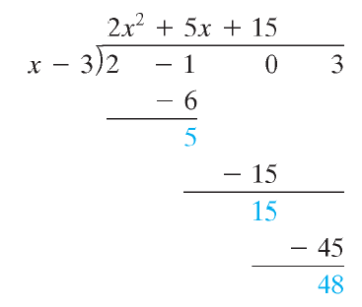
Copyright © 2012 Pearson Education, Inc. Publishing as Prentice Hall.

Slide 4
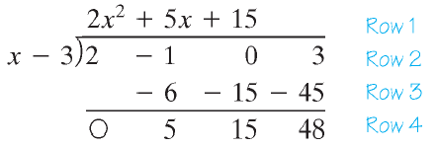
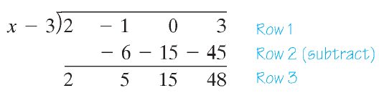
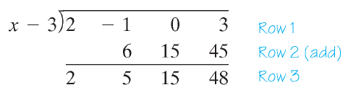
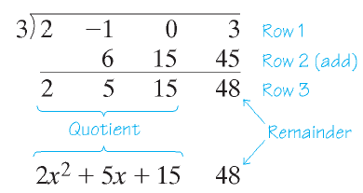
Copyright © 2012 Pearson Education, Inc. Publishing as Prentice Hall.

Slide 5


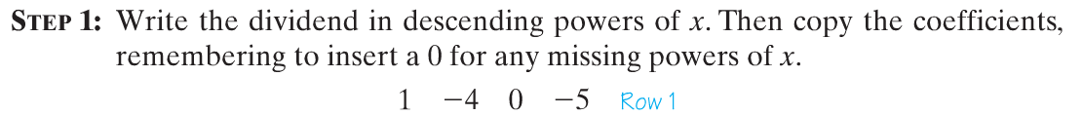
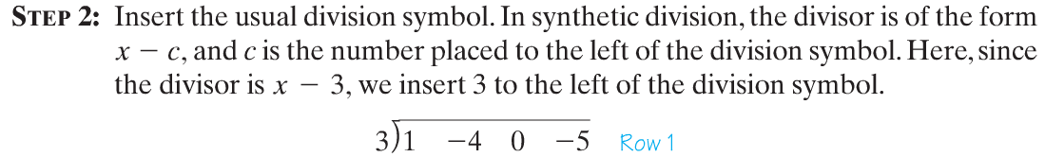
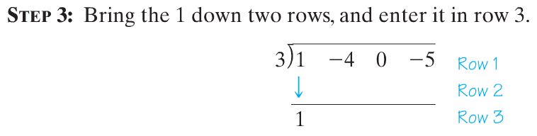
Copyright © 2012 Pearson Education, Inc. Publishing as Prentice Hall.

Slide 6
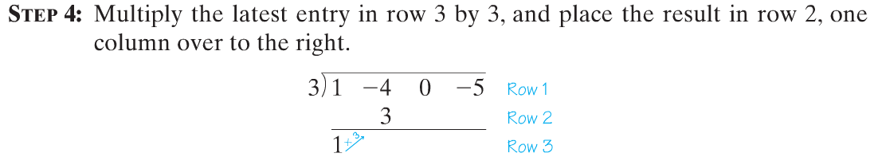
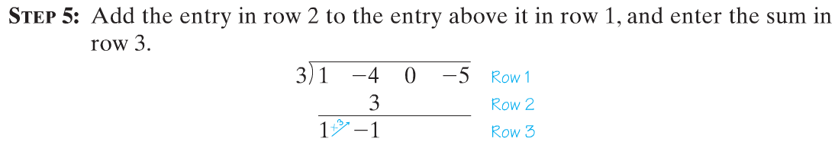
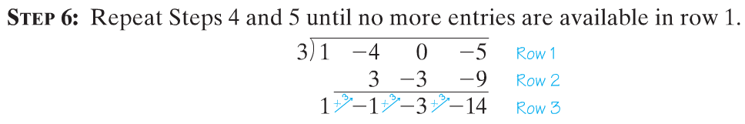
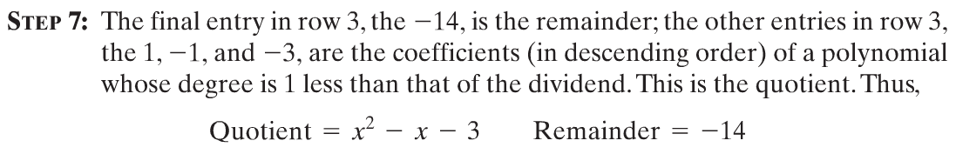
Copyright © 2012 Pearson Education, Inc. Publishing as Prentice Hall.

Slide 7
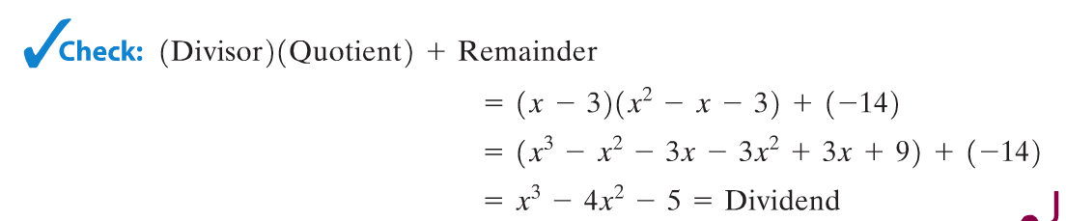
Copyright © 2012 Pearson Education, Inc. Publishing as Prentice Hall.

Slide 8

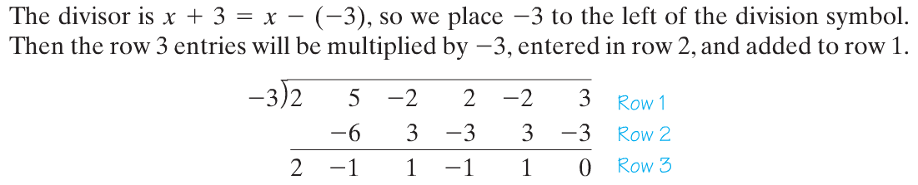
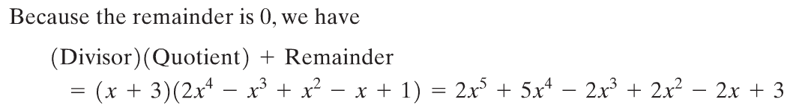
Copyright © 2012 Pearson Education, Inc. Publishing as Prentice Hall.

